Slide 1
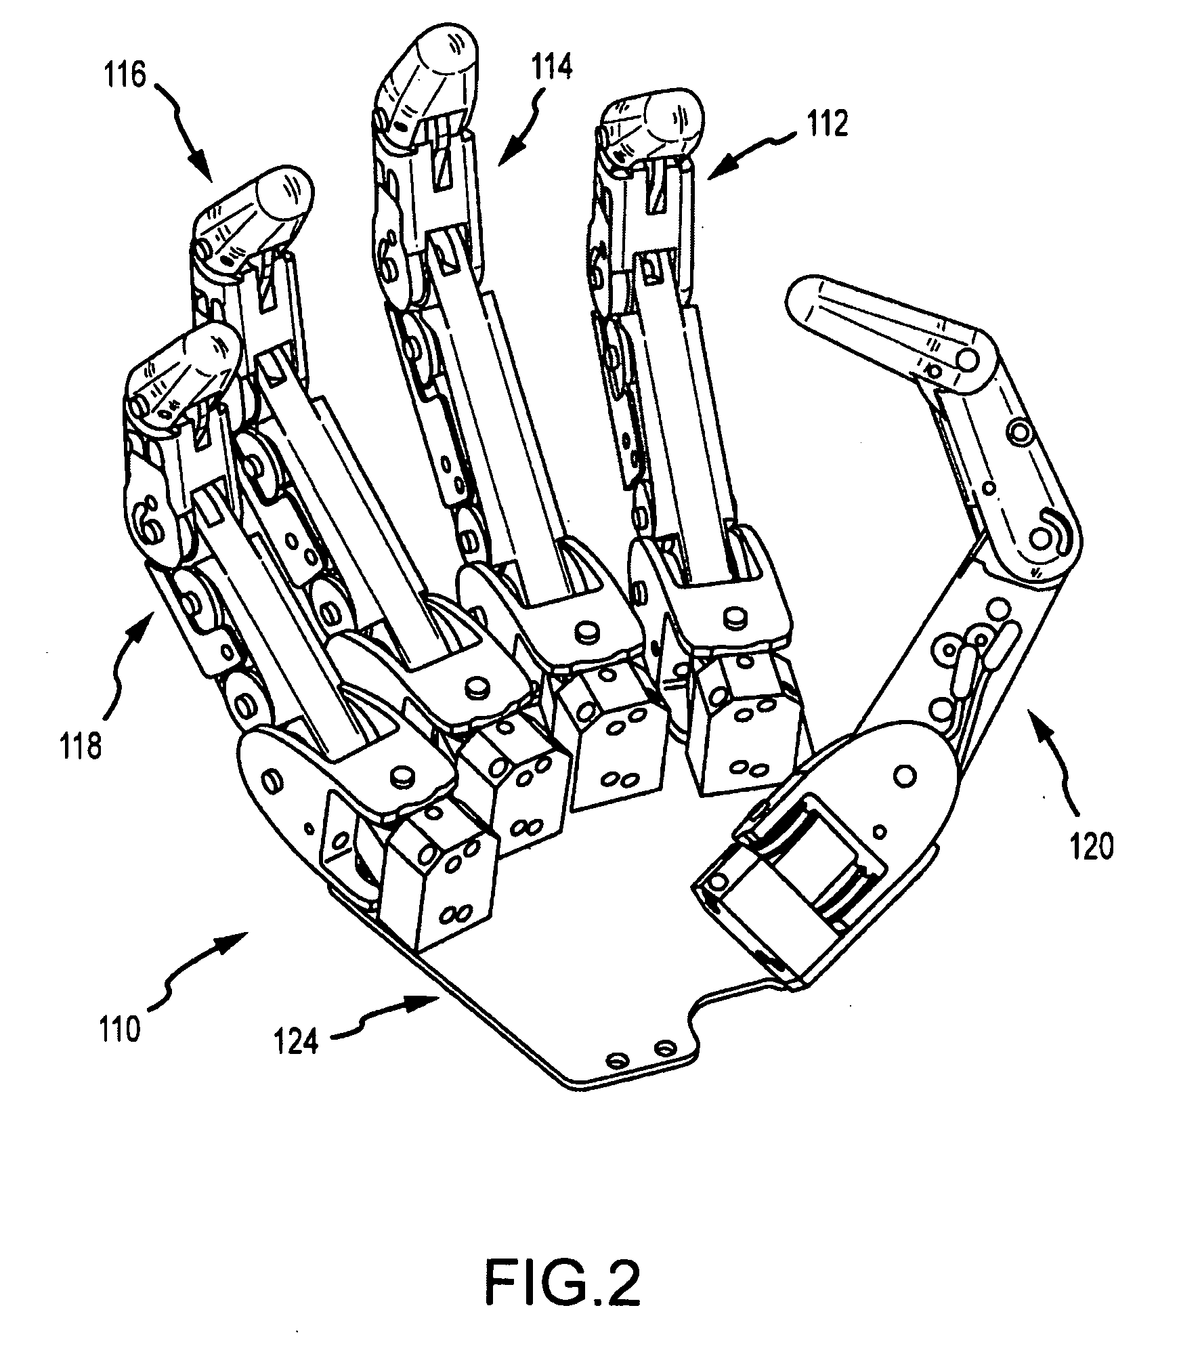

WIRELESS ROBOTIC ARM
GROUP 46.
TEAM MEMBERS:
16.02.2018
PROJECT GUIDE: Prof ANAND
SHASHIKUMAR K 1PE14EC132
R S KARAN 1PE14EC103
KALAVATHI HK 1PE15EC411
ANUJA HALYAL 1PE14EC022

Slide 2
OBJECTIVE
To make a wireless robotic arm that imitates a human hand.
To throw and catch a ball thrown vertically up.
To have the sense of touch to differentiate between a hard and a soft object.

Slide 3
BLOCK DIAGRAM
HAND GLOVE
MICROCONTROLLER
nRF24L01
nRF24L01
MICROCONTROLLER
SERVO MOTORS
Robotic arm
Solenoid
PRESSURE SENSOR

Slide 5
HARDWARE REQUIREMENTS

Slide 6
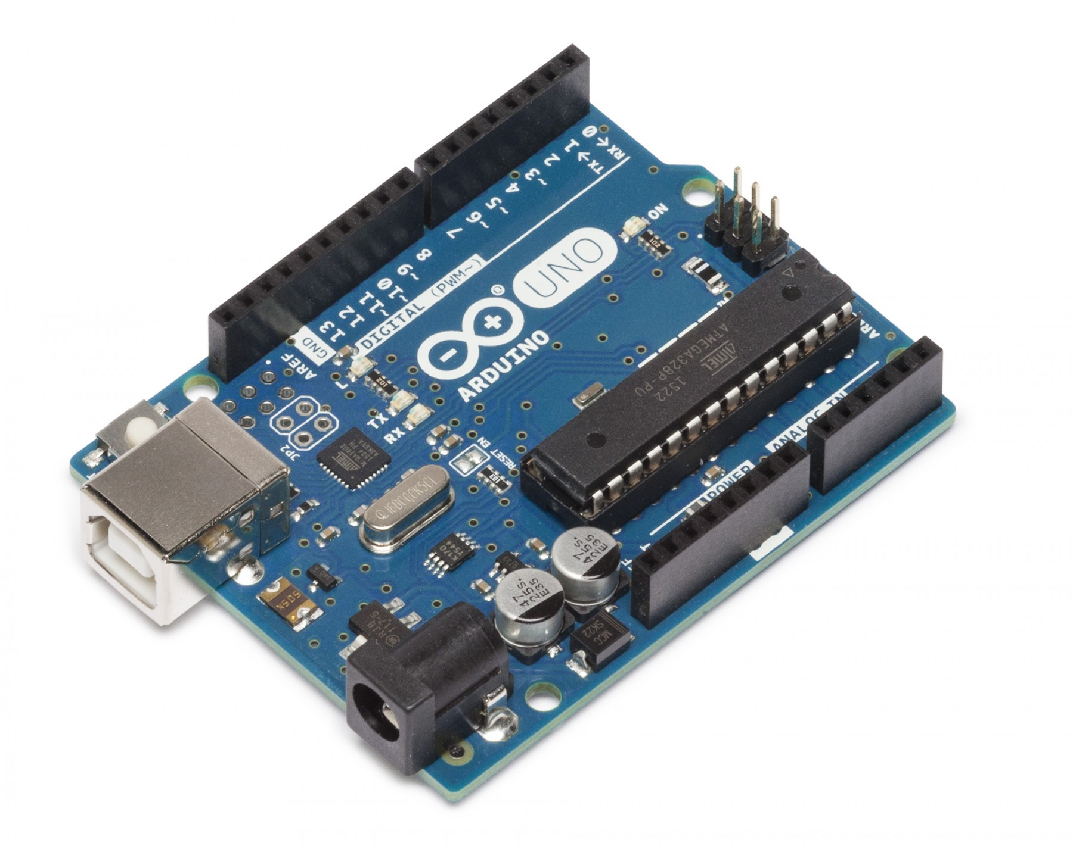
ARDUINO - UNO
Based on Atmega328
I/P voltage : 7-12V
14 Digital I/O pins( 6 as PWM outputs)
6 Analog inputs
Inbuilt 5V,3.3V voltage regulators
Inbuilt ADC with 10-bit resolution
32k FLASH MEMORY

Slide 7
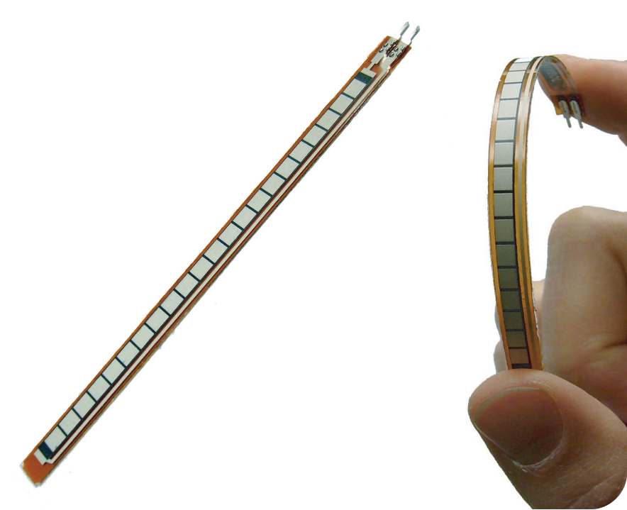
FLEX SENSORS
Work as voltage dividers
Resistance changes depending on the bend
Change in bend is proportional to the electrical resistance
Thin strips 1’’-5’’ long
Resistance Range:1.5K-40K ohms

Slide 8
SERVO MOTORS
DC motor working with the principle of SERVOMECHANISM
Automatically operated up to certain limit for a given command with help of error-sensing feedback to correct the performance

Slide 9
Solenoid

Slide 10
Pressure Sensor

Slide 11
GLOVES
Estimated Cost
ROBOTIC ARM
Estimated Cost
SERVO MOTORS : 400Rs
Pressure Sensor :500Rs
MICROCONTROLLER : 500-800Rs
Nrf module :200rs
Robotic hand material(foam and tubes):1000
FLEX SENSORS :600*5=3000Rs
MPU6050: 300Rs
MICROCONTROLLER : 500-800Rs
Nrf module : 200Rs
Total Estimated Cost: 6500Rs

Slide 12
Gesture/Finger | Thumb | Index | Middle | Ring
Claw
Loose claw
Peace
Thumbs up

Slide 13
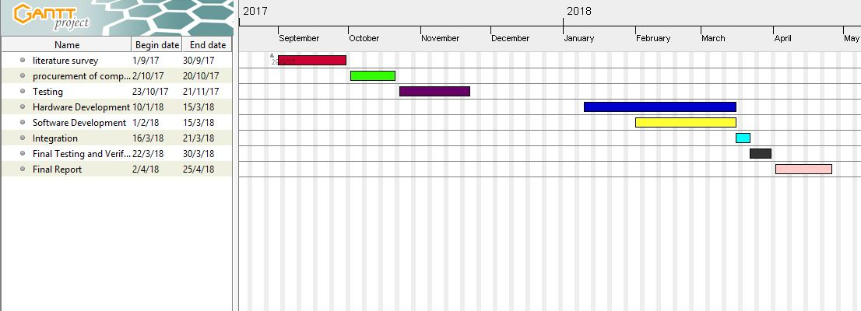
GANTT CHART

